Slide 1
Pacific Cod Stock Dynamics: US and Russian Components
Spawning biomass, exploitation, and climate context
1977–2024

Slide 2
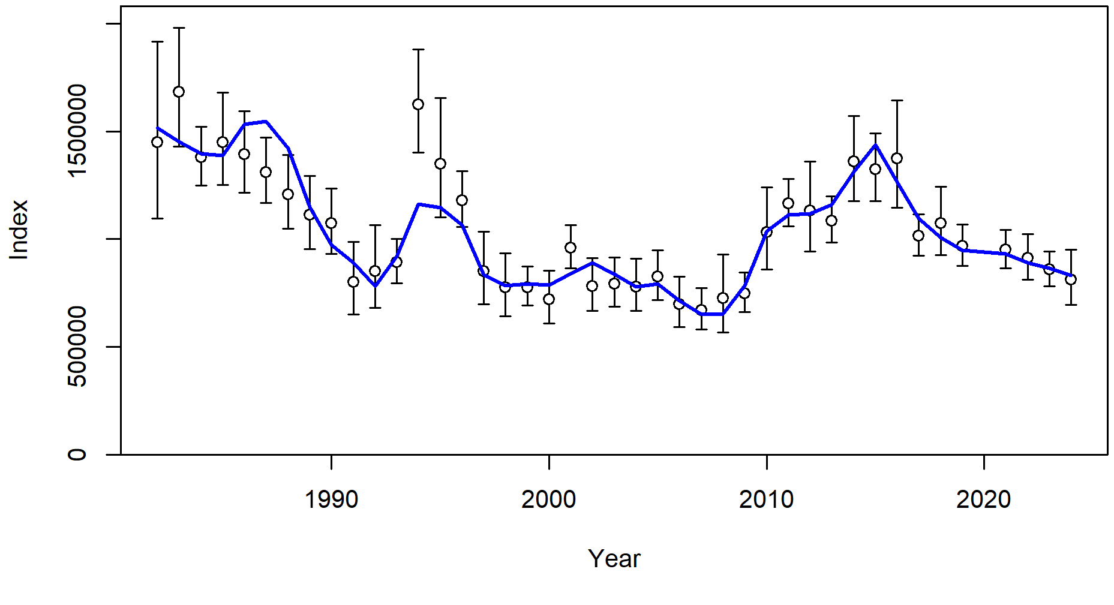
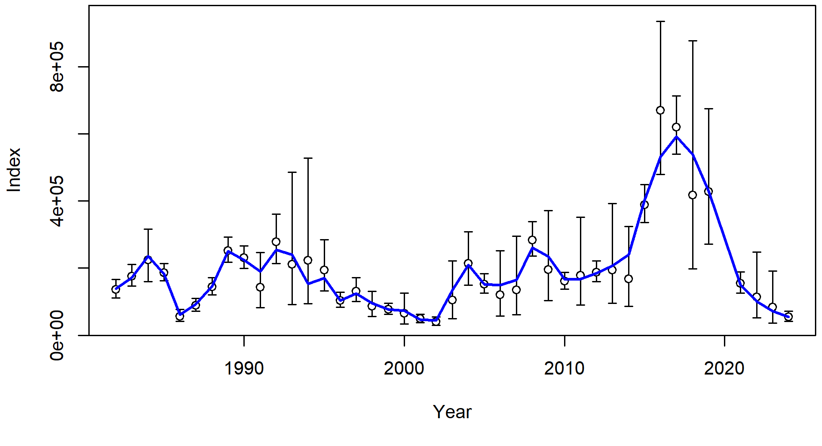
Index fits
EBS/NBS+WGOA index
WBS index

Slide 3
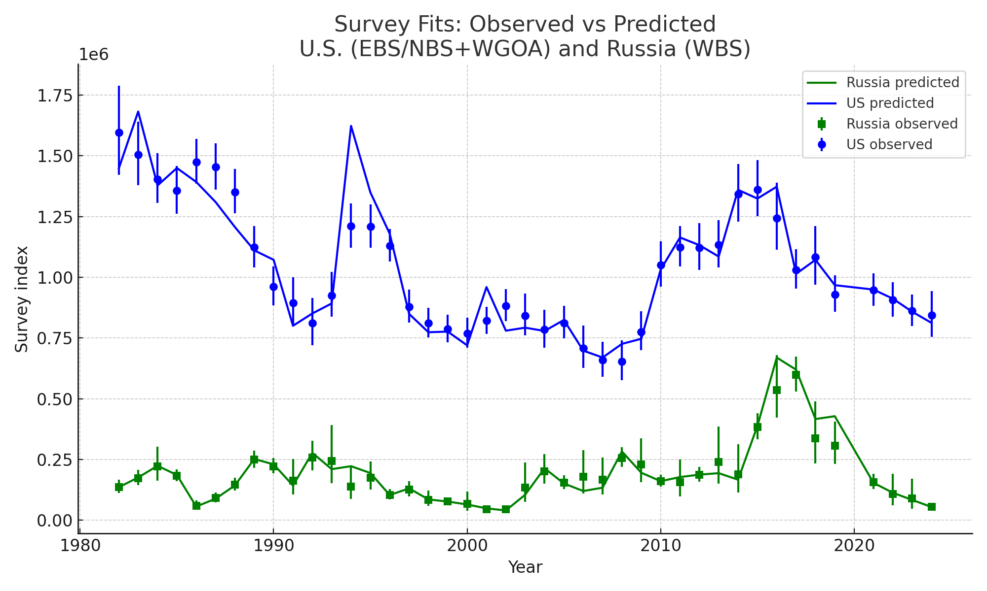
Survey Index Fits (Observed vs Predicted)

Slide 4
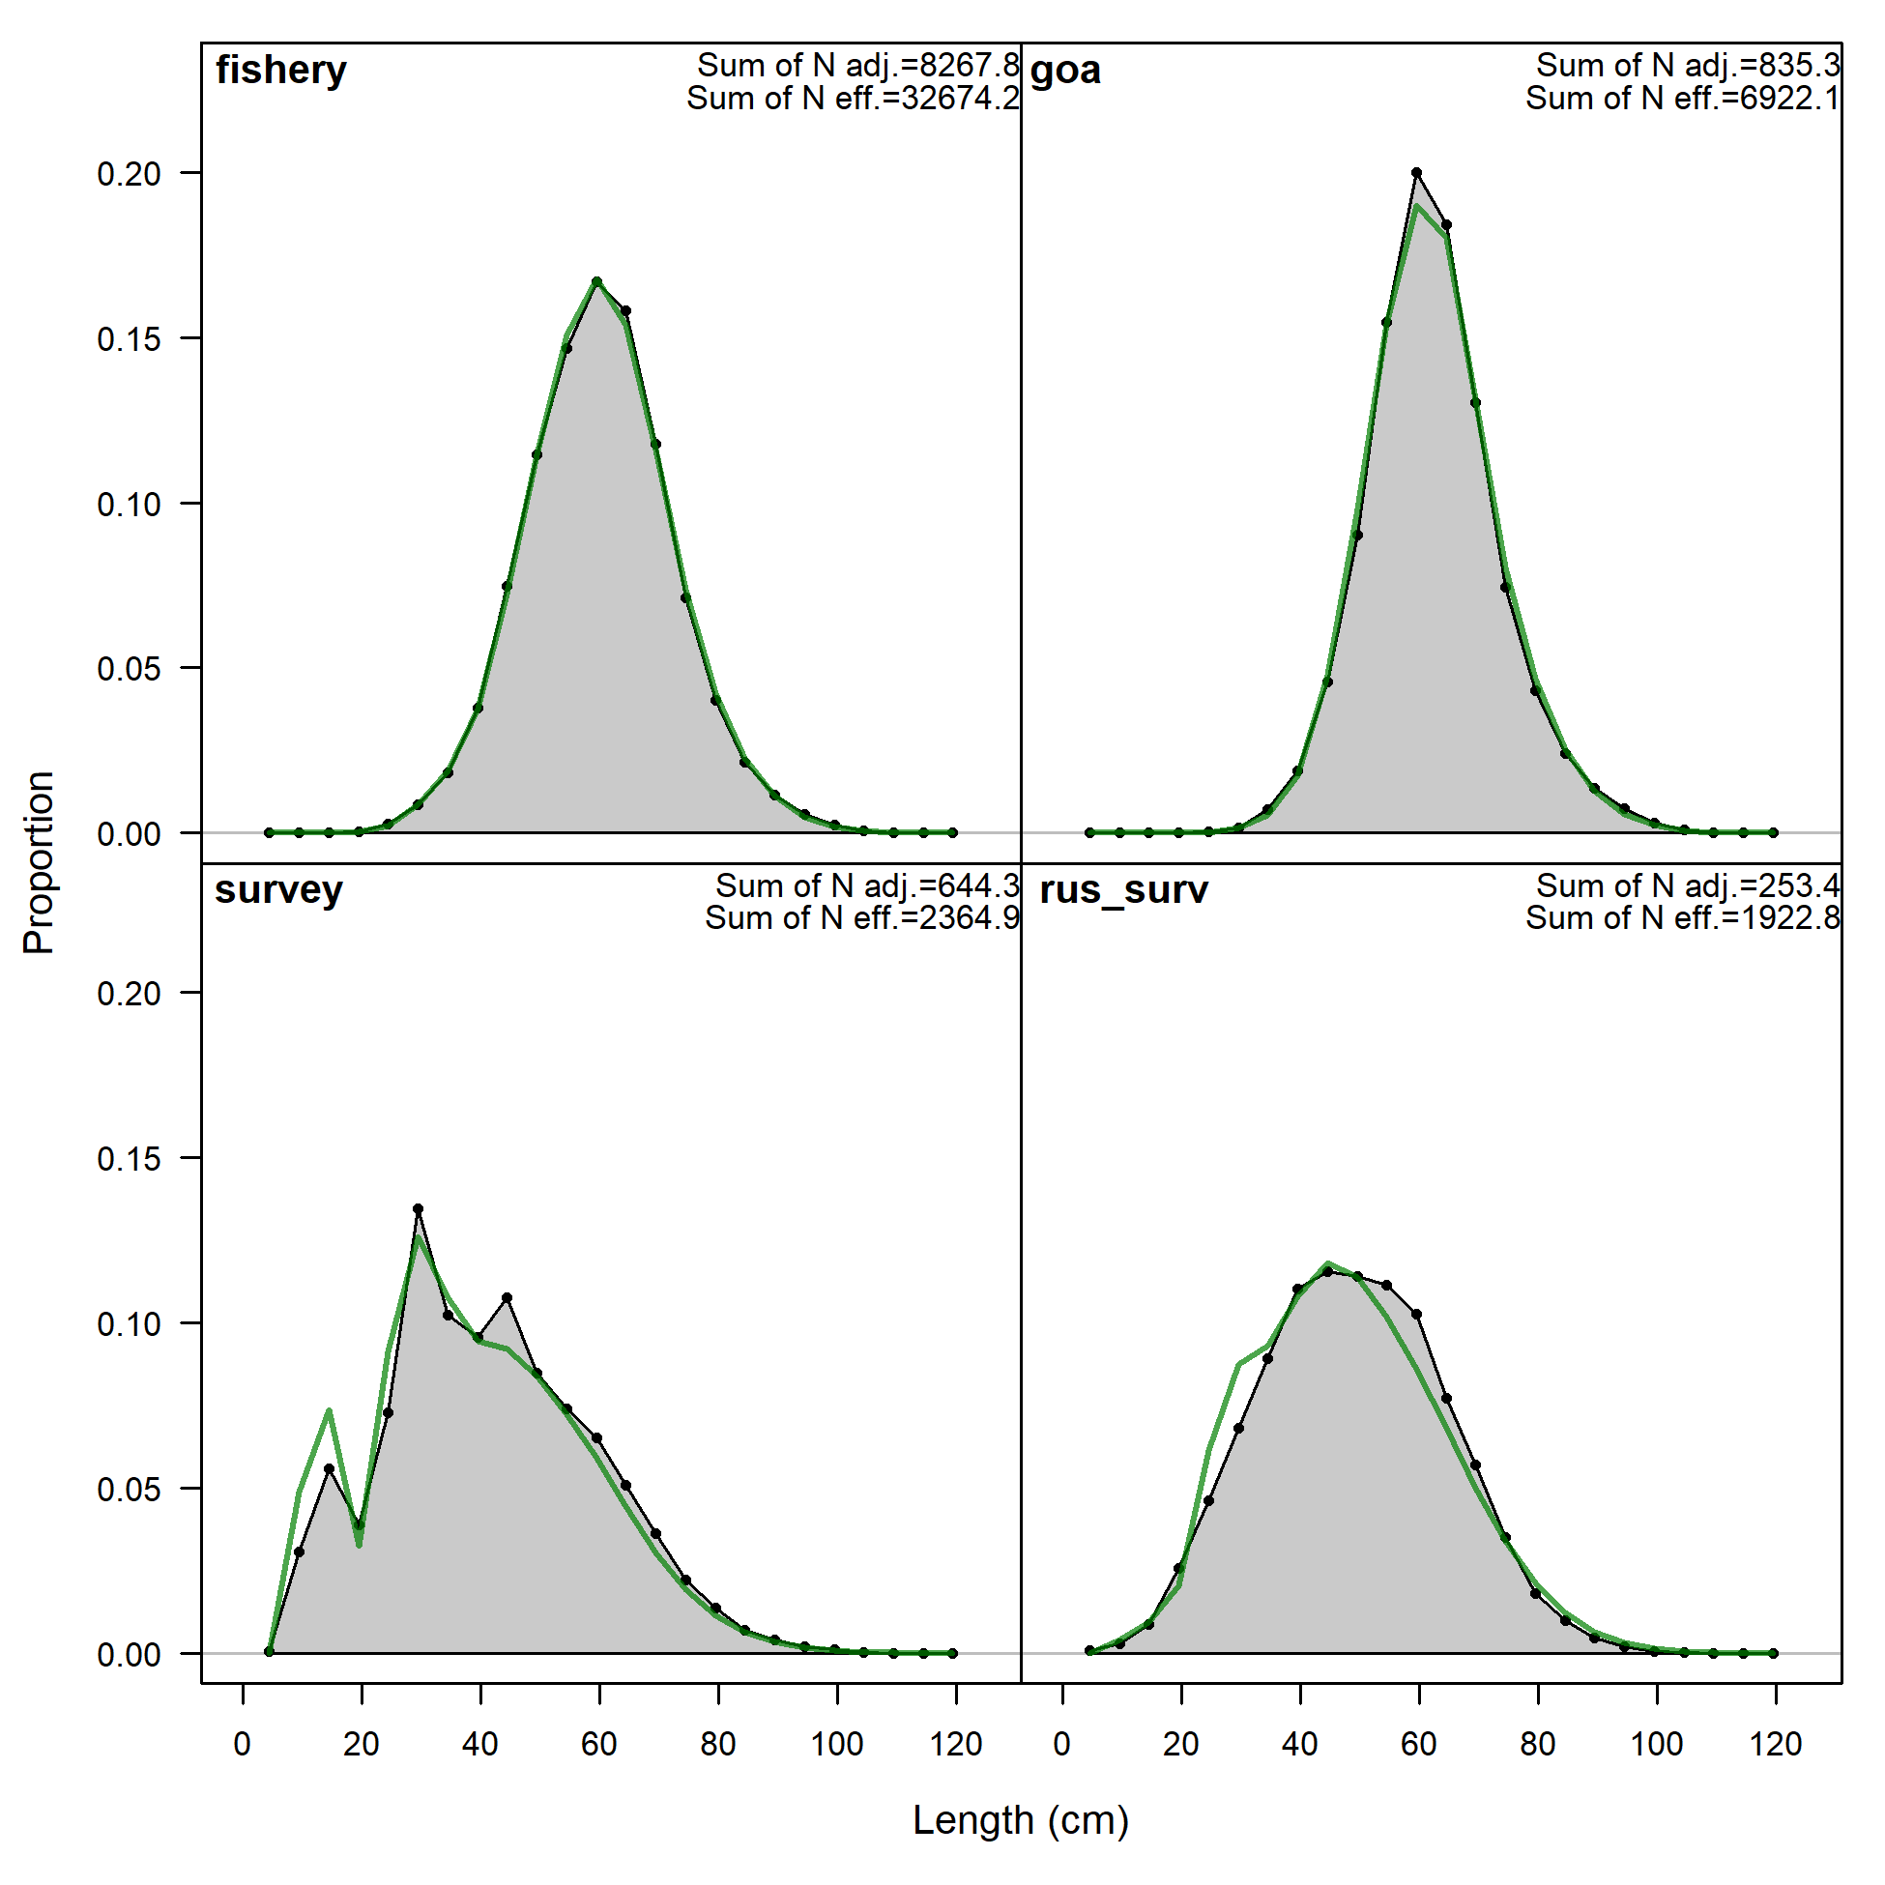
Composit Length Comp Fits

Slide 5
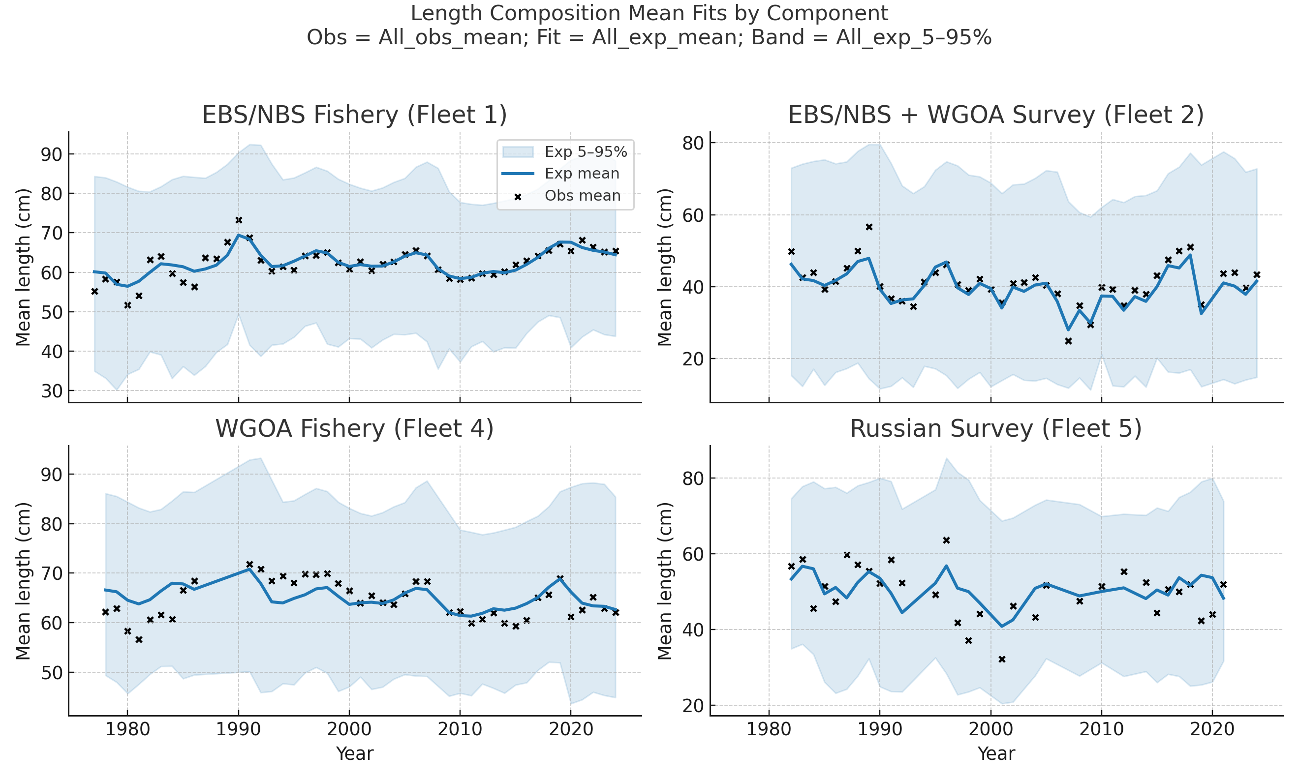
Length Composition Mean Fits by Component

Slide 6
Key Results
US spawning biomass peaked at 0.92 Mt in 1983; declined post-2016
Russian WBS biomass pulse in 2017 (~0.34 Mt, 35% of total)
Russian catches >350 kt (2018–2021); US catches stable ~650 kt
Exploitation peaked near F=1.4 in 2021, driven by WBS
Warm 2010s anomalies aligned with WBS surge

Slide 7
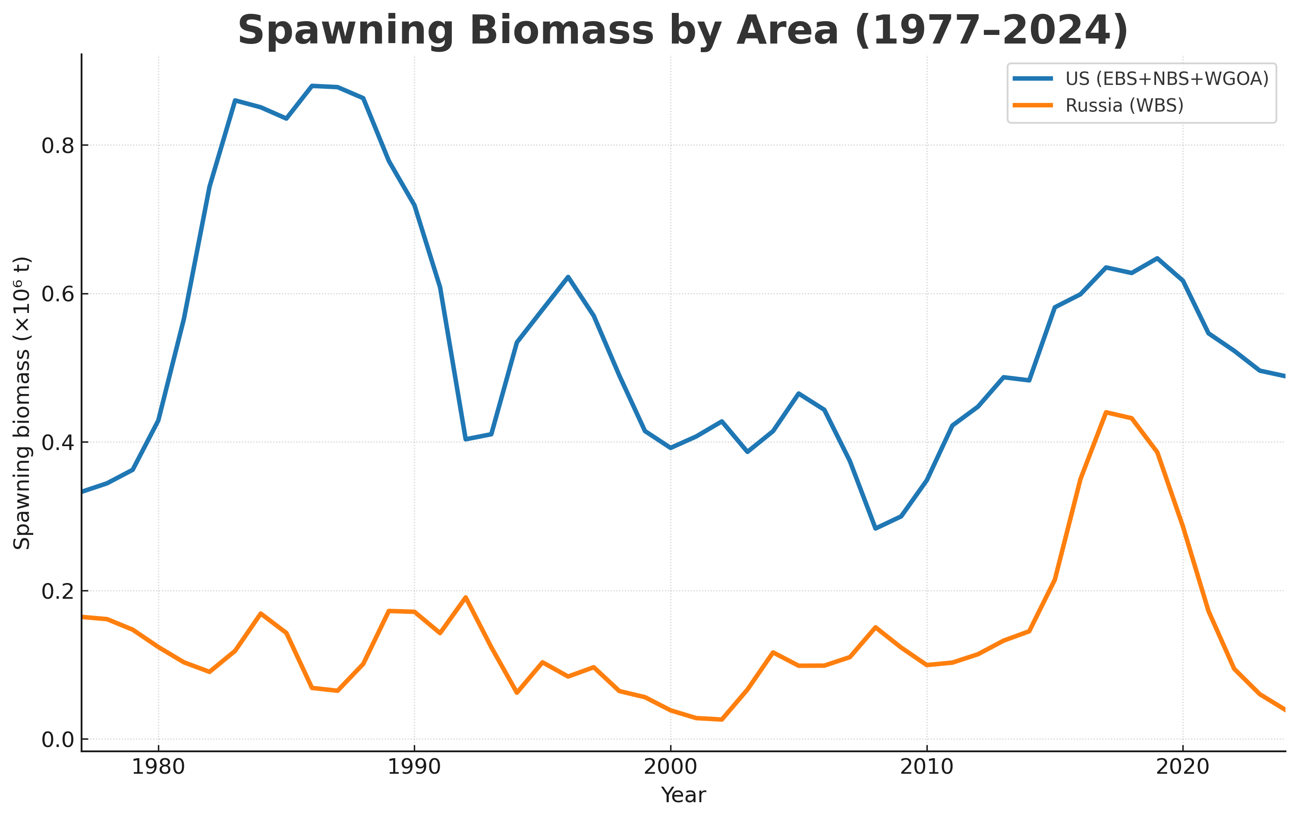
Spawning Biomass by Area (1977–2024)

Slide 8
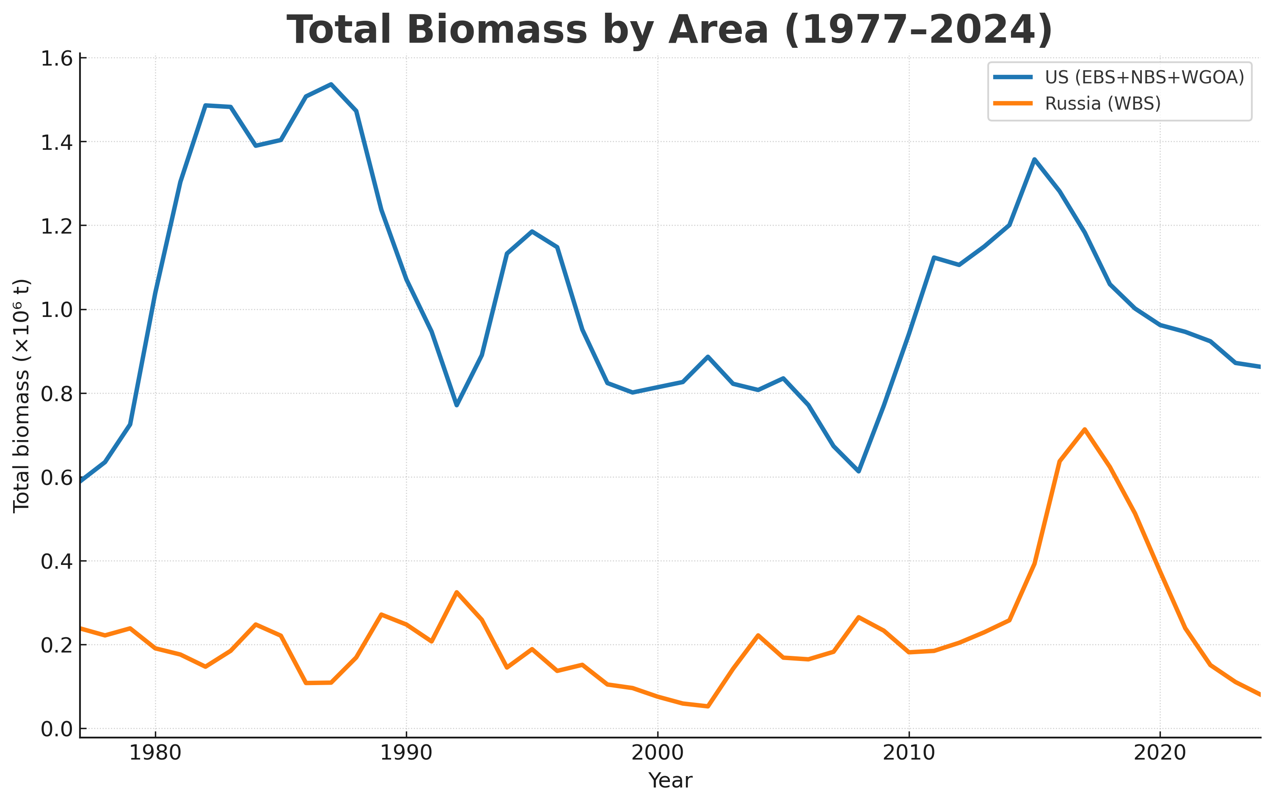
Total Biomass by Area (1977–2024)

Slide 9
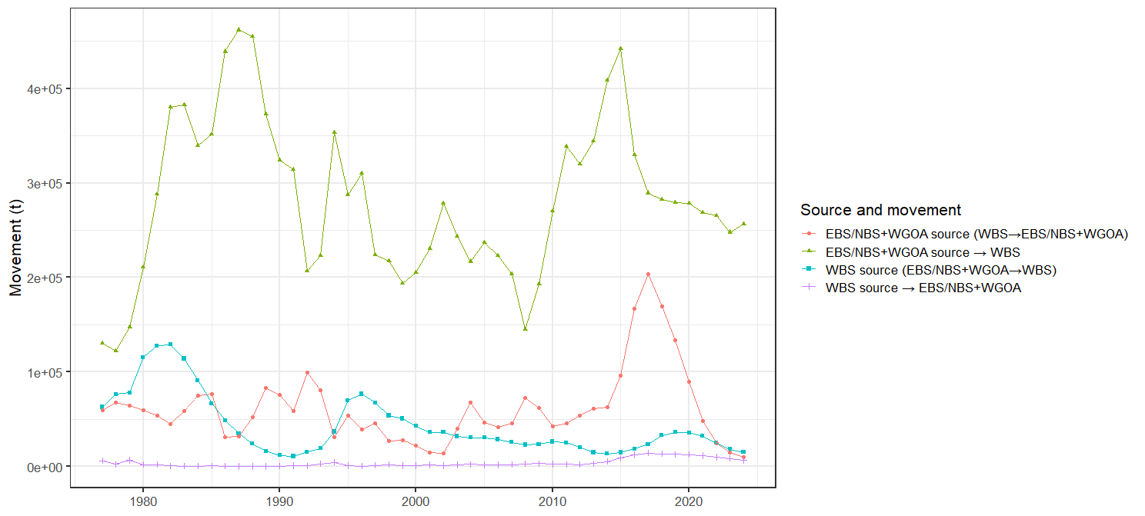
Movement by Recruitment Source, Annual Source Area and Destination

Slide 10
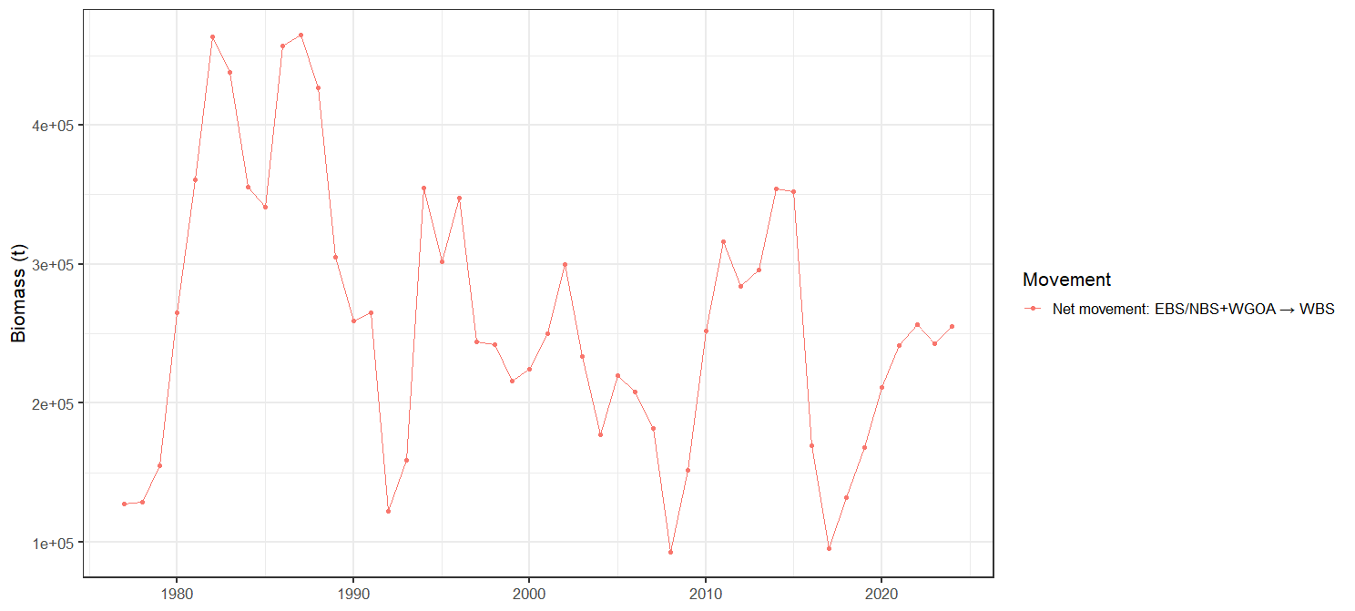
Net Movement from EBS/NBS+WGOA to WBS

Slide 11
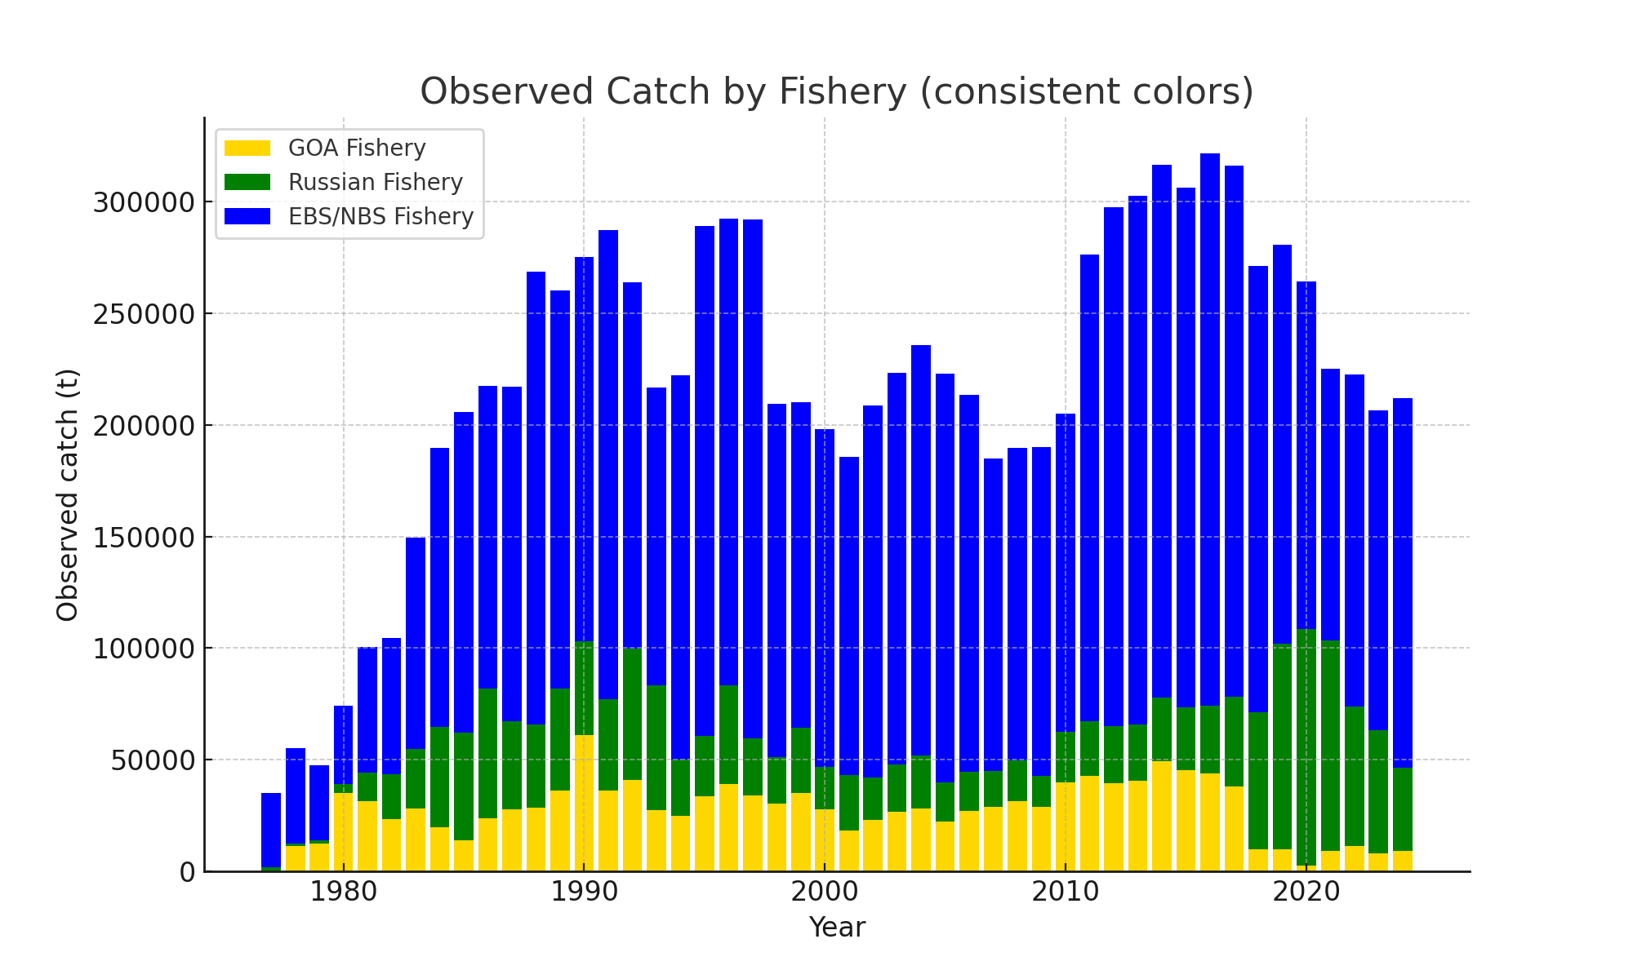
Observed Catch by Fishery

Slide 12
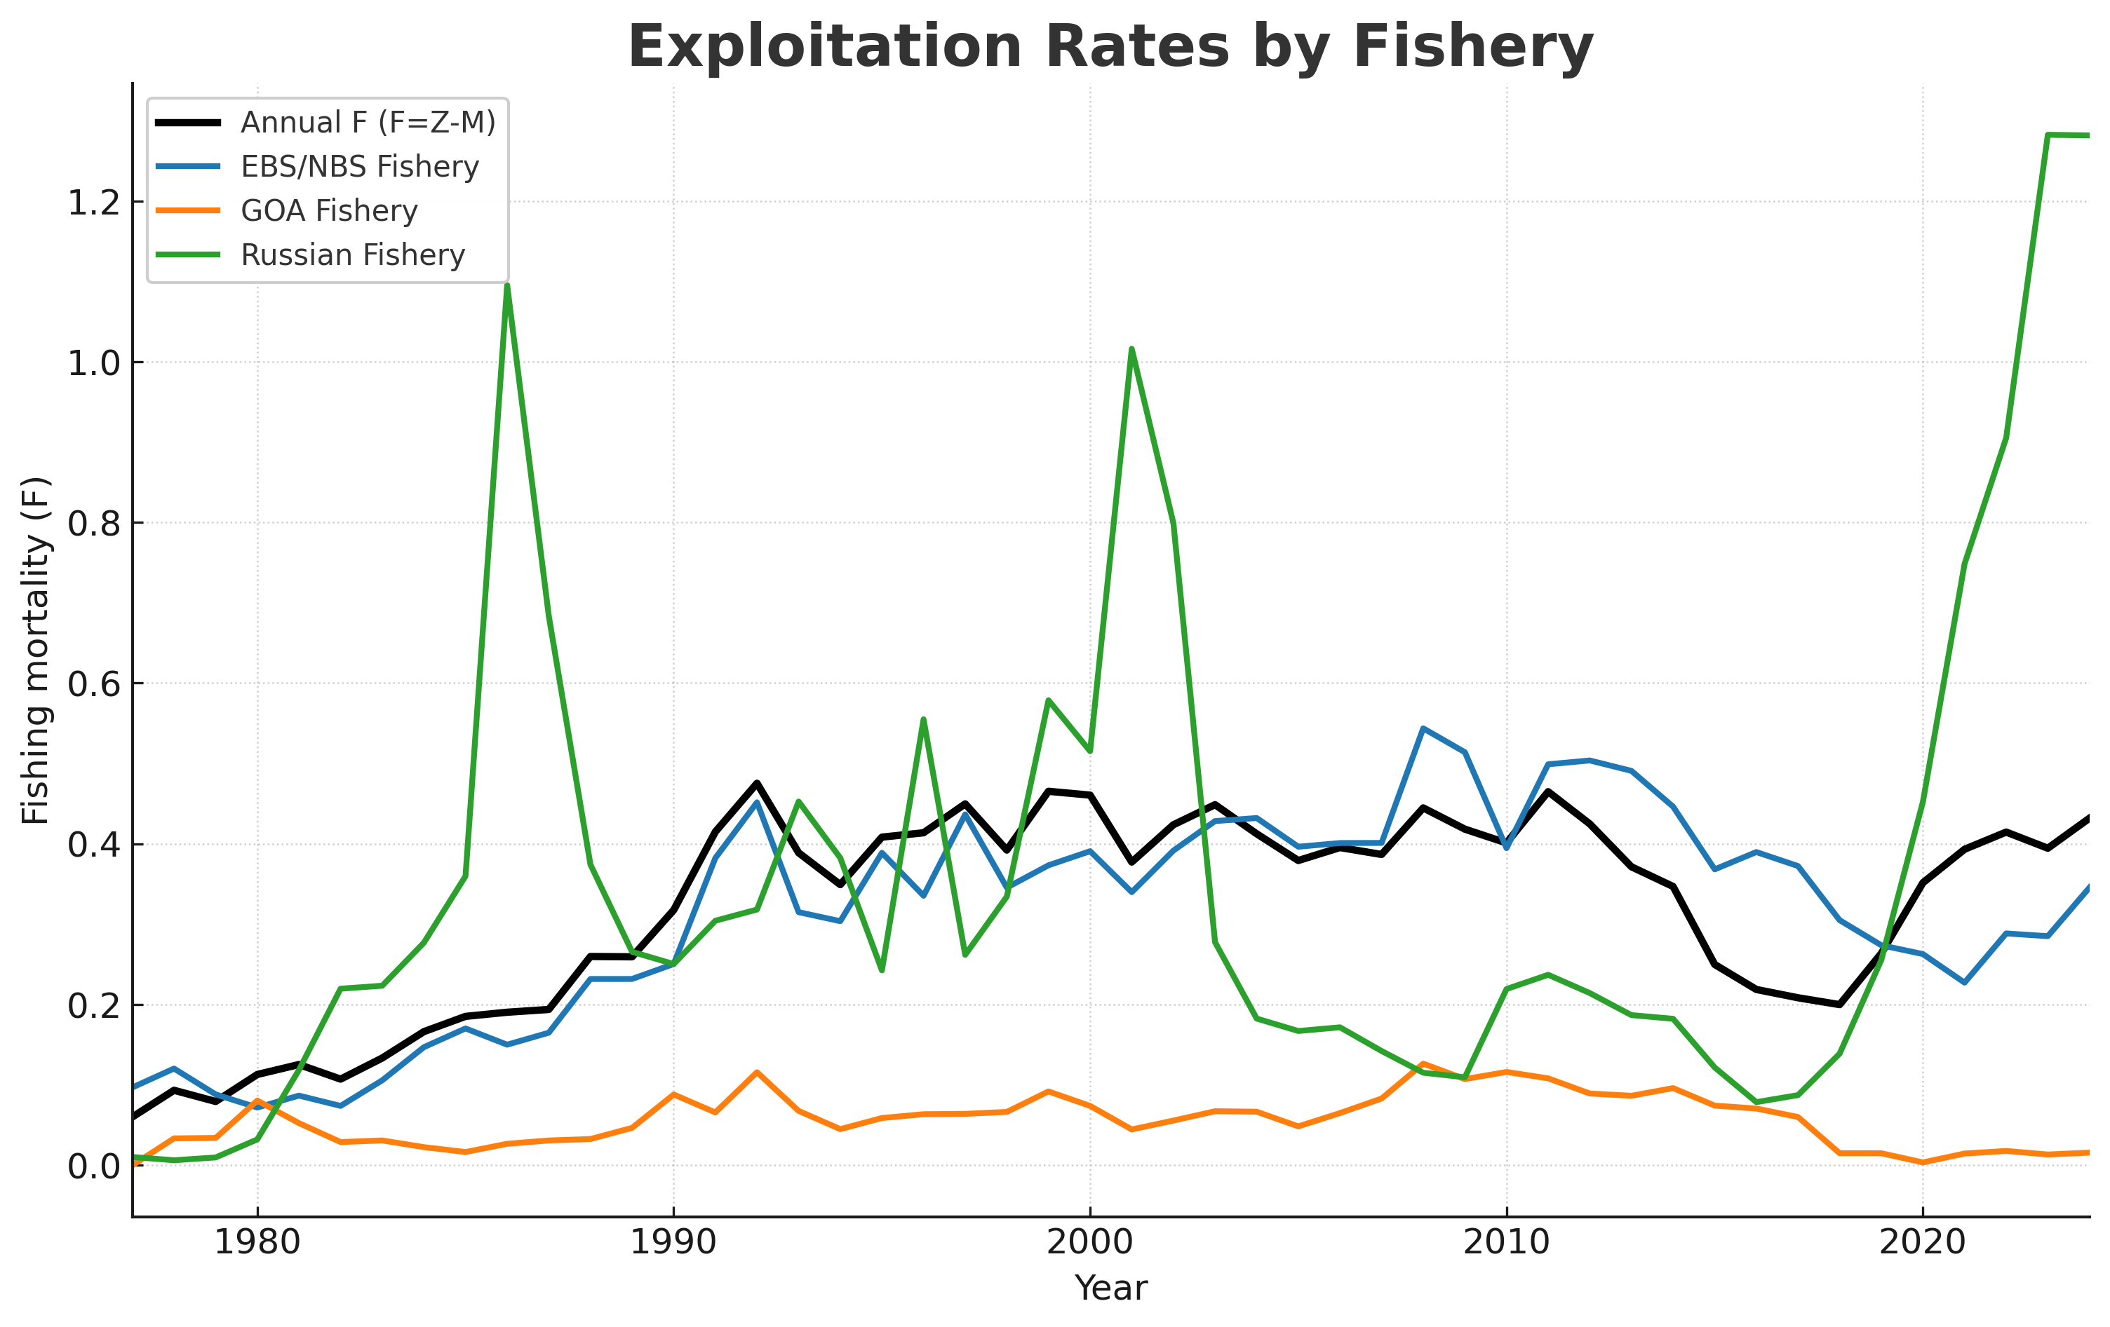
Exploitation Rates by Fishery

Slide 13
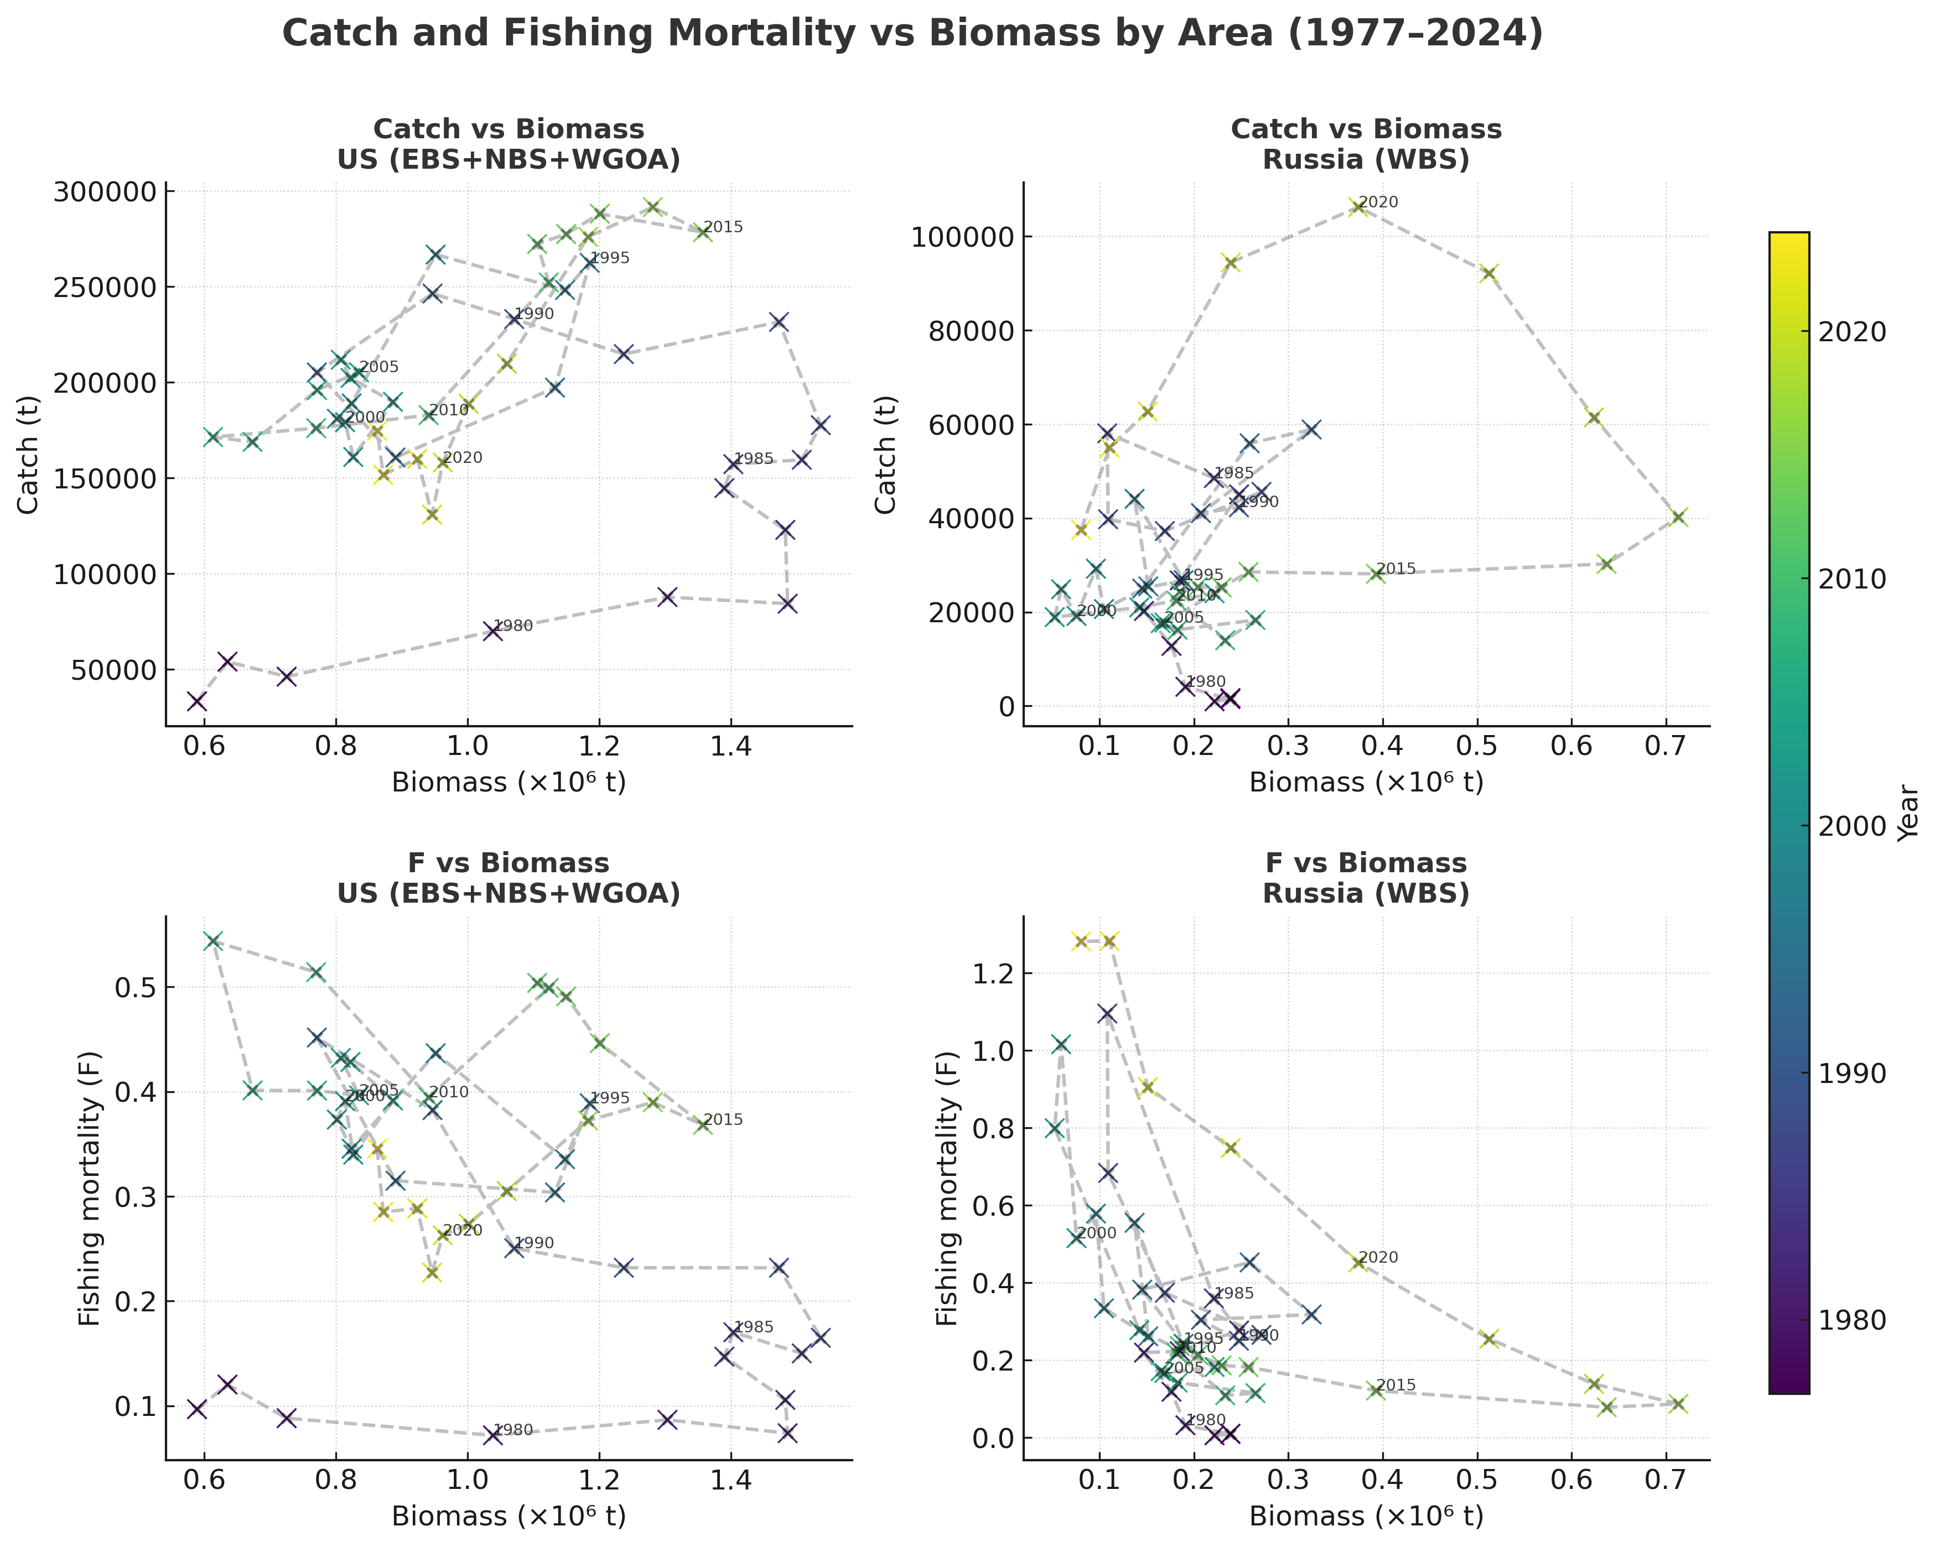
Catch and Fishing Mortality vs Biomass by Area (1977–2024)

Slide 14
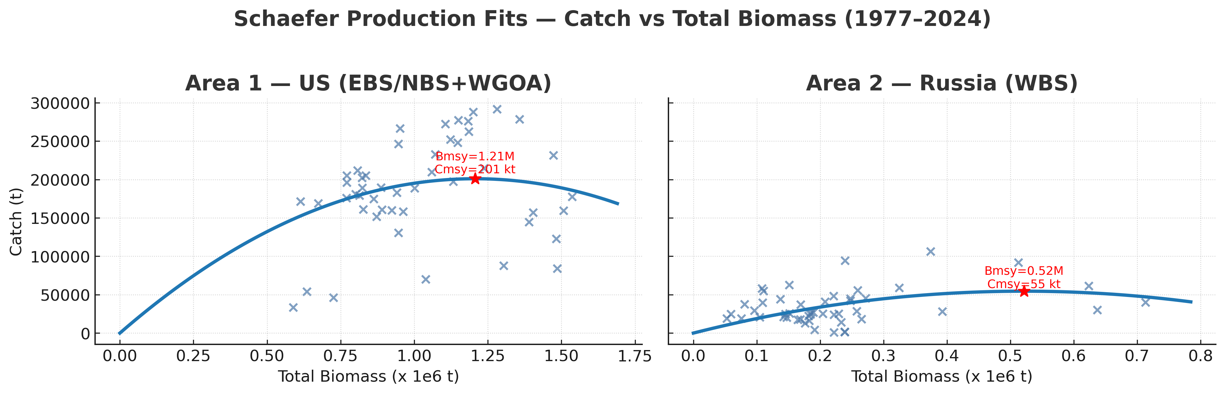
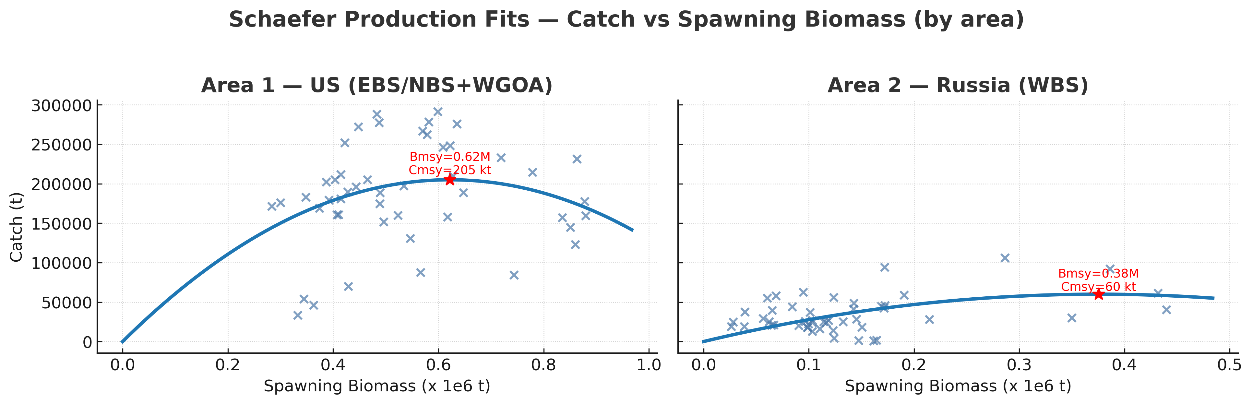

Slide 15
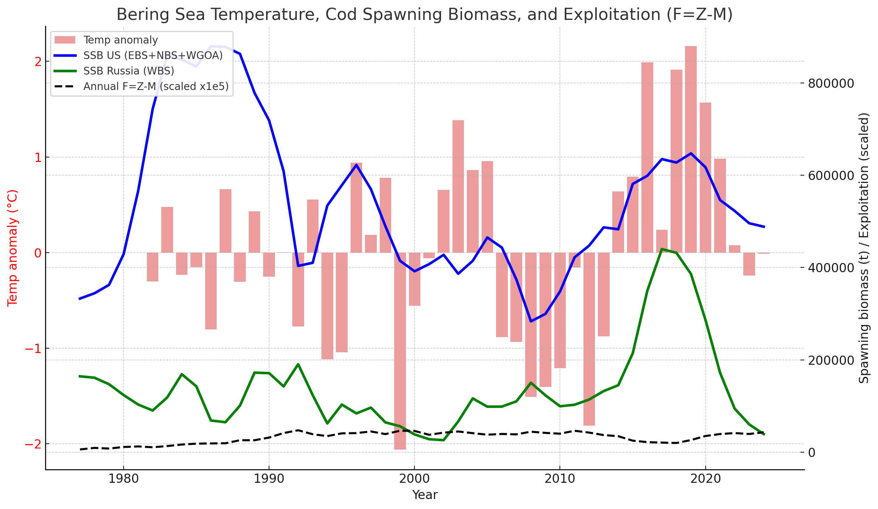
Climate, Biomass, and Exploitation (1977–2024)

Slide 16
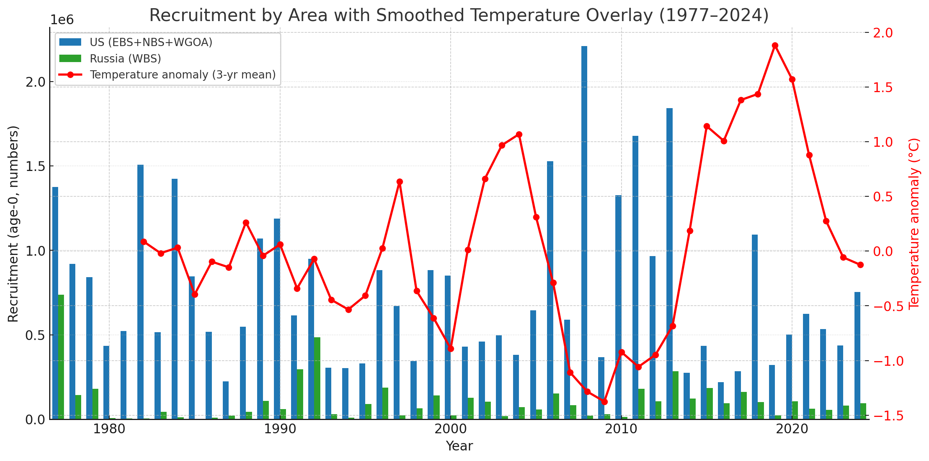
Recruitment by Region with 3-year Smoothed Temperature

Slide 17
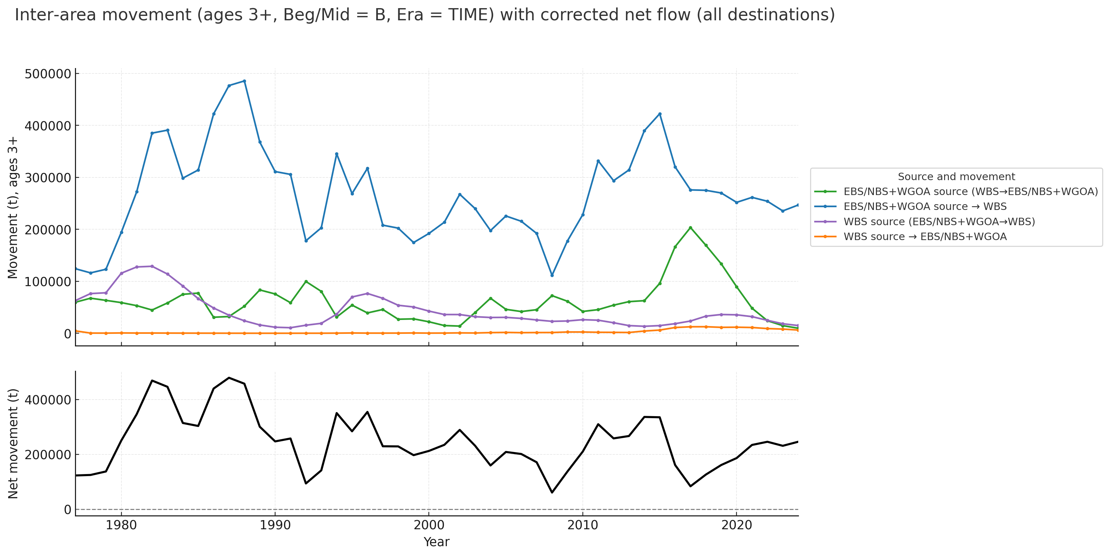
Movement between areas
The average net movement (EBS/NBS+WGOA → WBS minus WBS → EBS/NBS+WGOA) from 1982–2024 is:
≈ 253,278 t
t per year

Slide 18
Management Implications
Warm-period expansions into Russian waters added major biomass
These pulses were heavily fished by Russian fleets, raising total F
Excluding Russian data underestimates both biomass and removals
Climate variability drives distribution shifts; management must adapt

